Slide 1
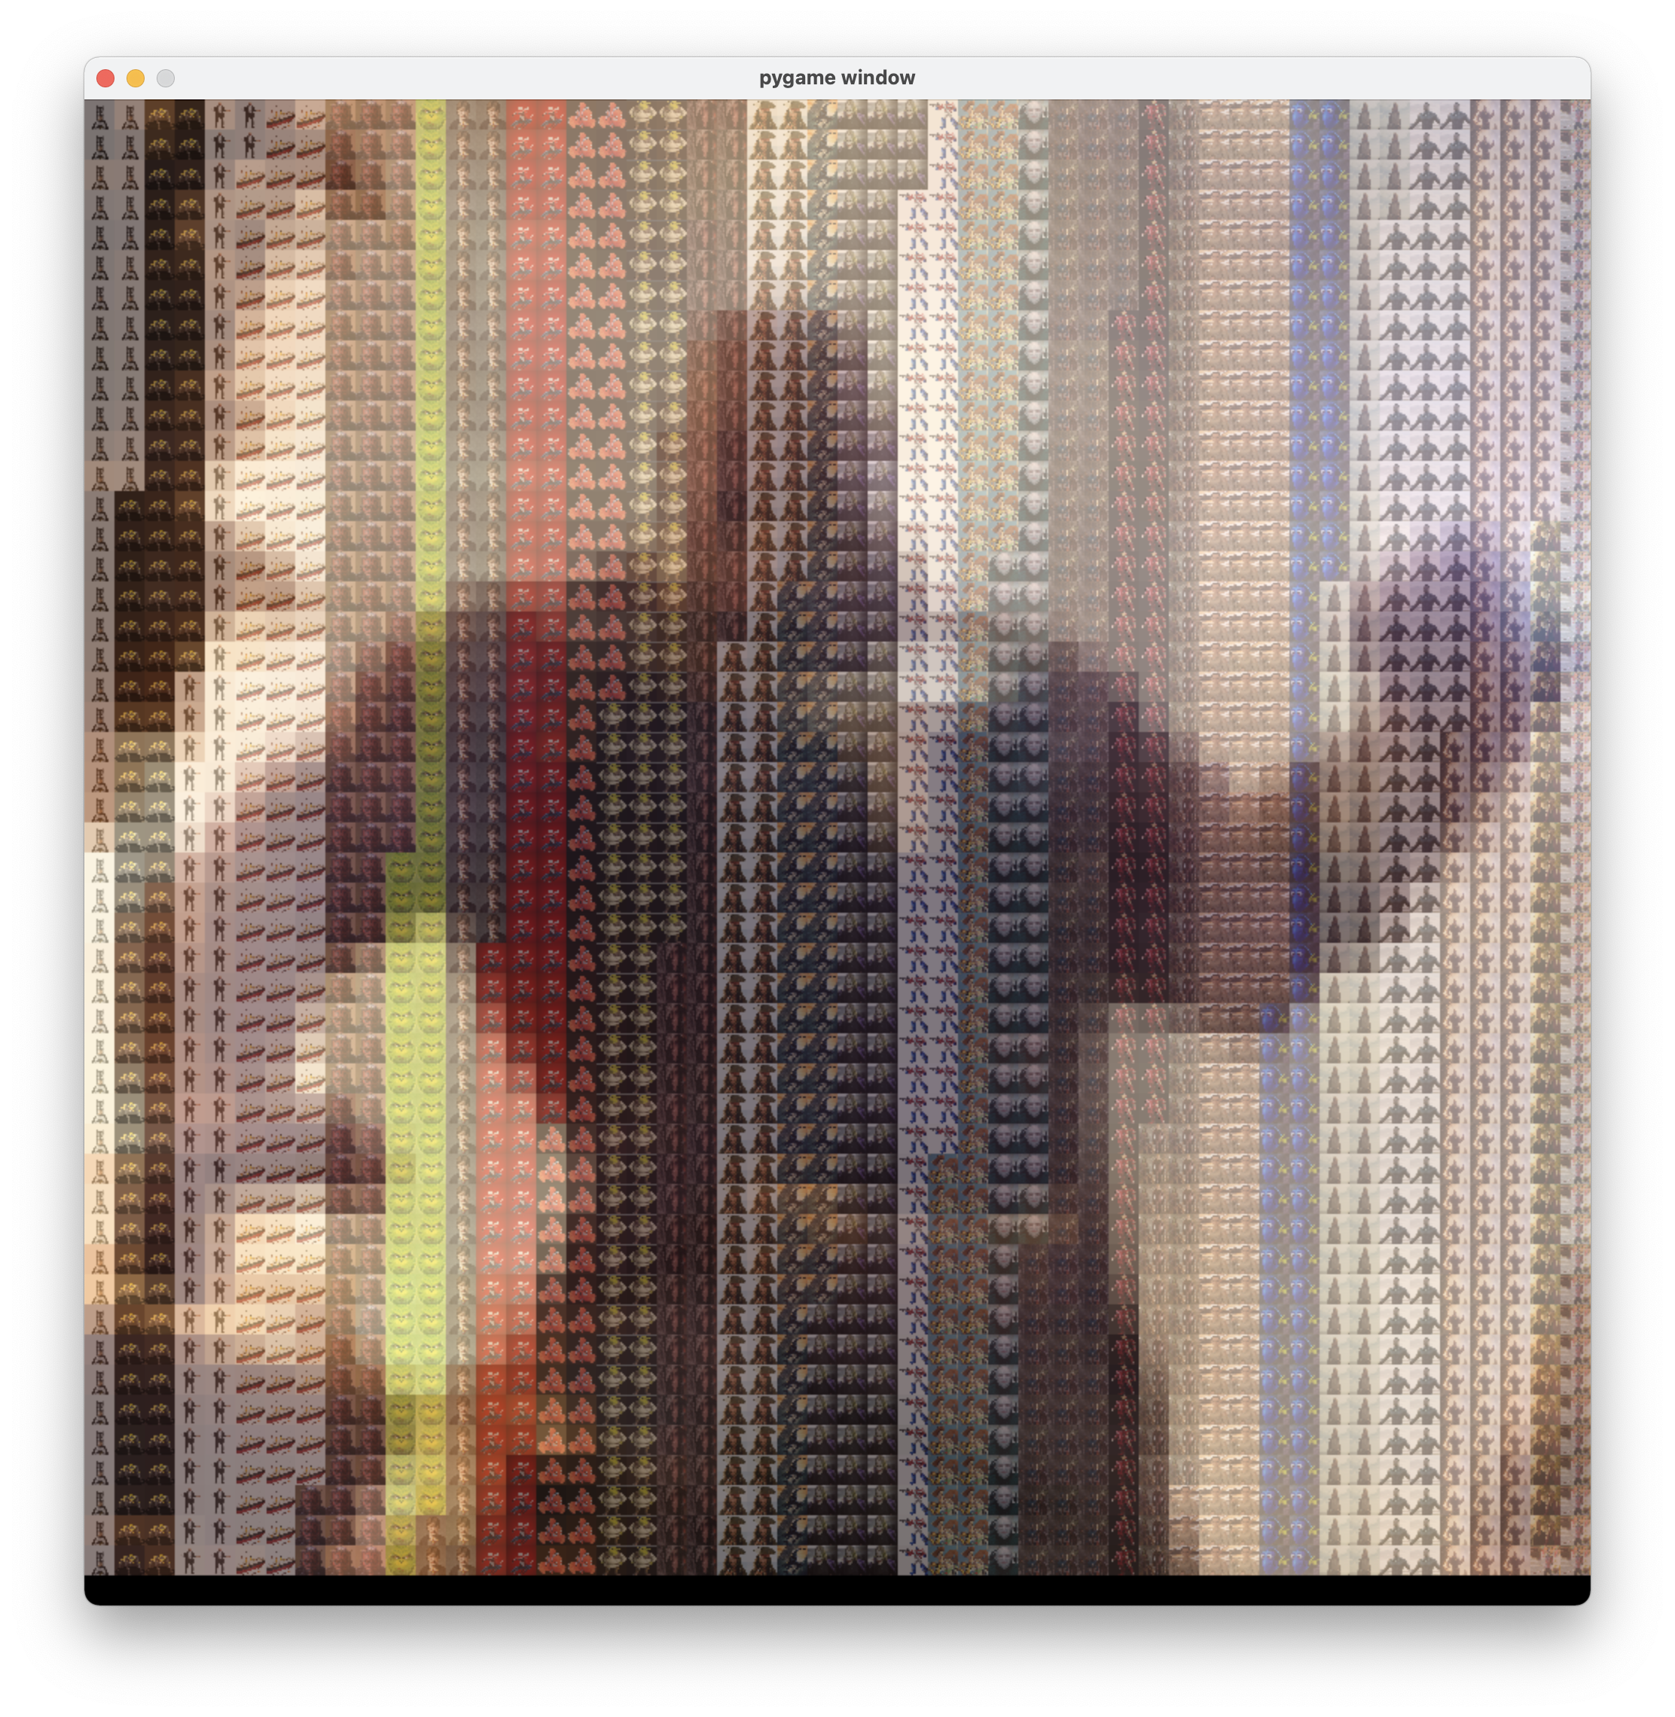
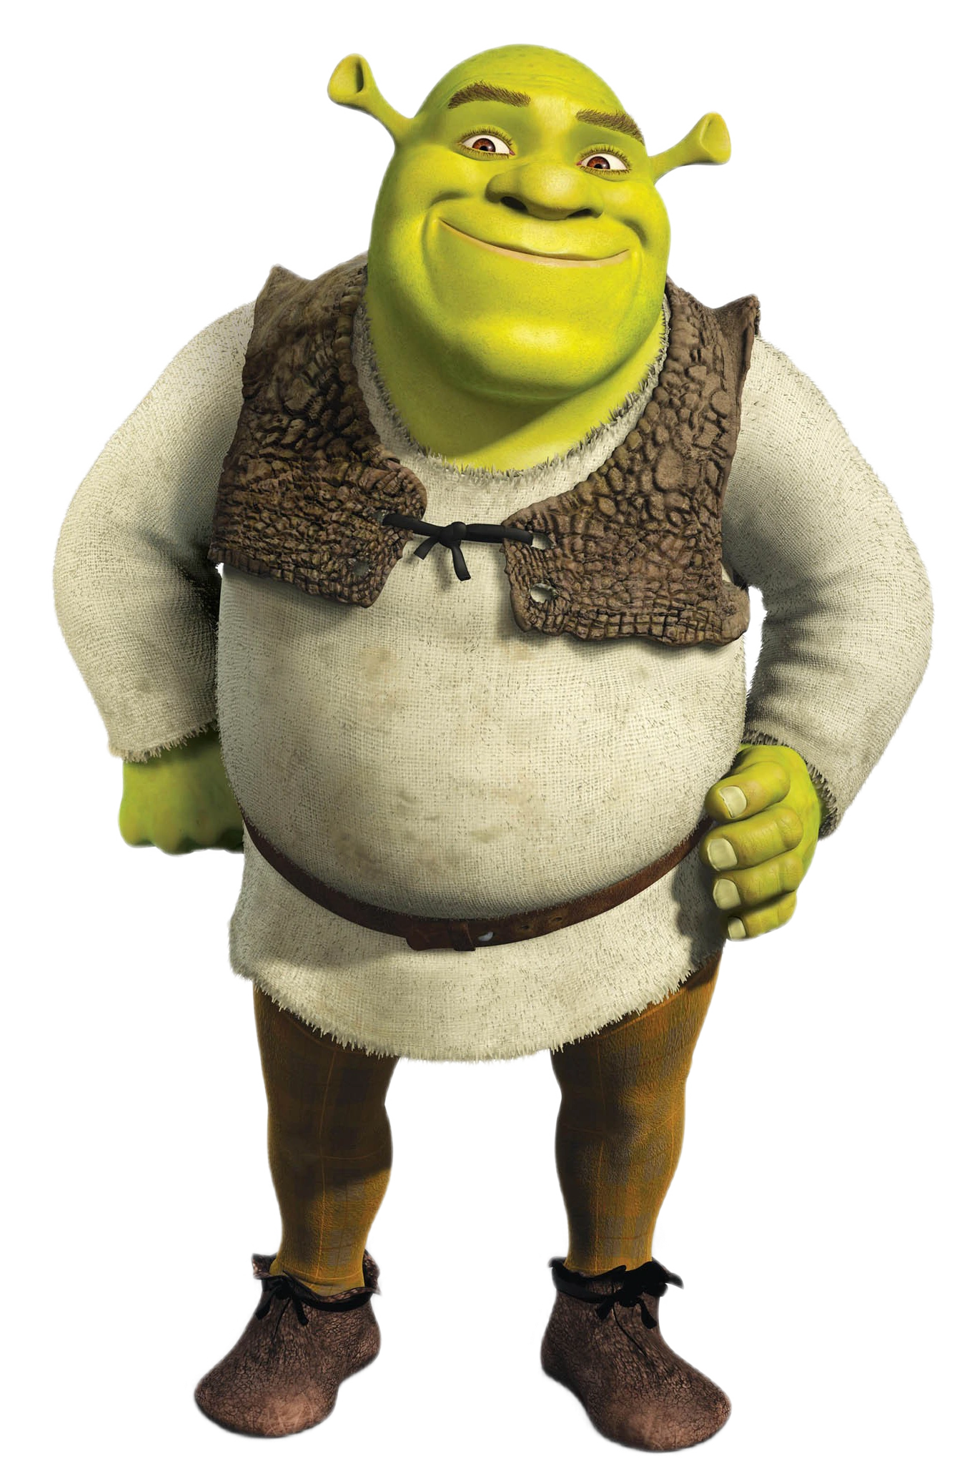
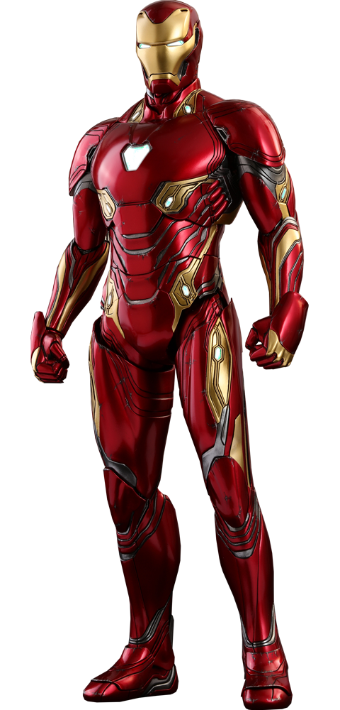


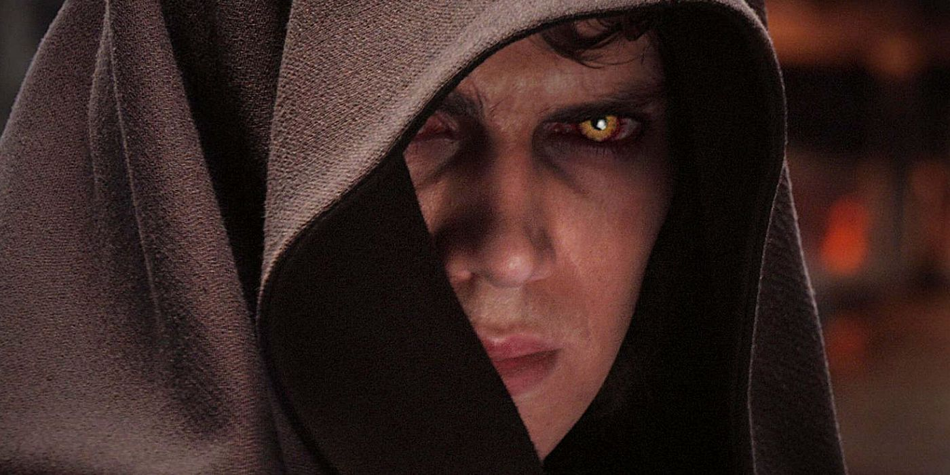
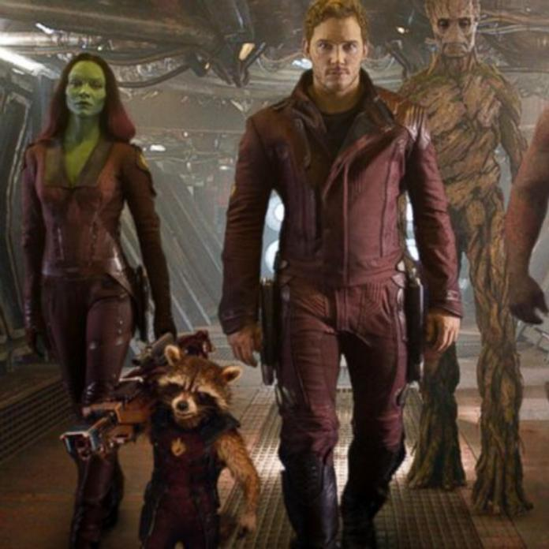

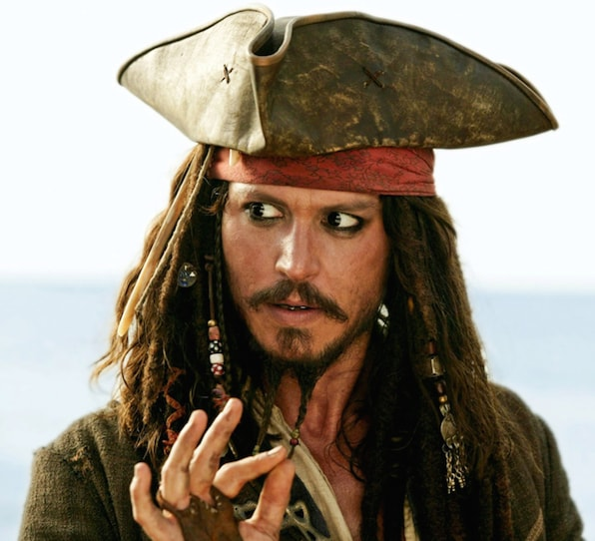
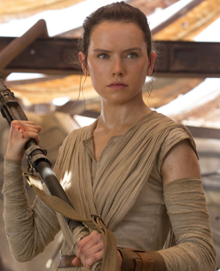
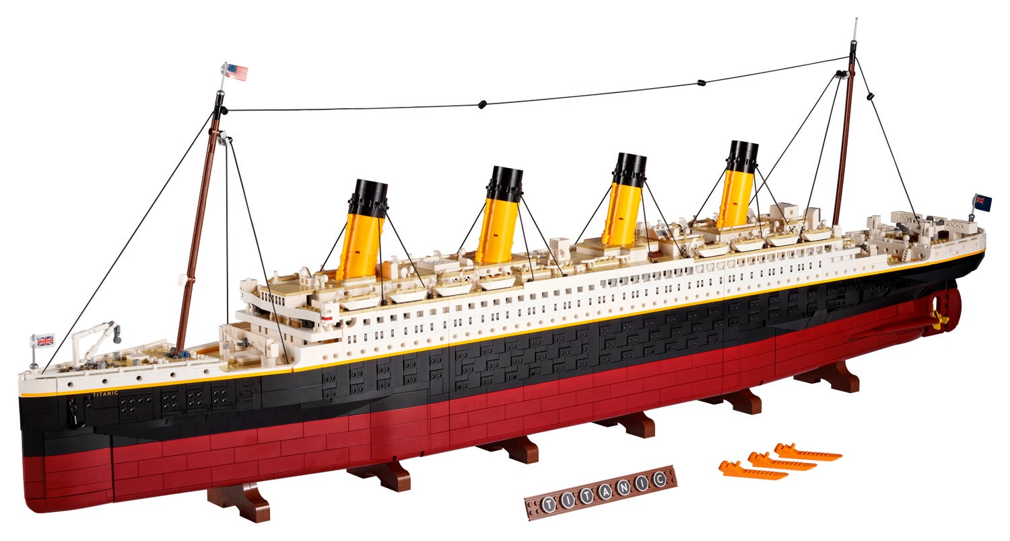

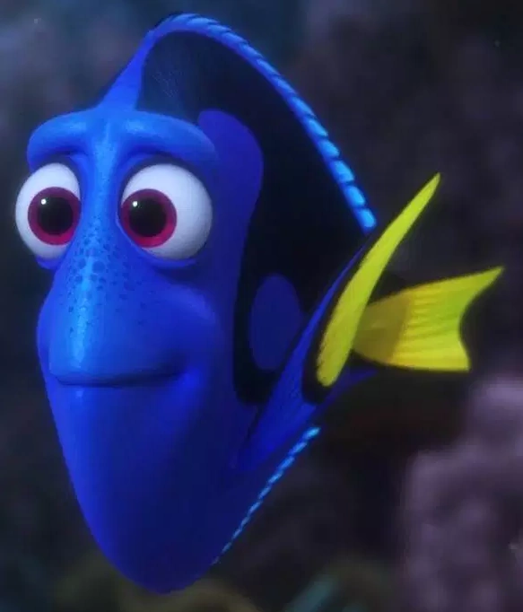
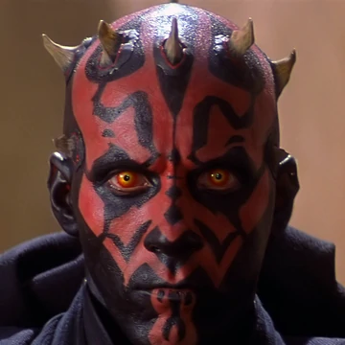

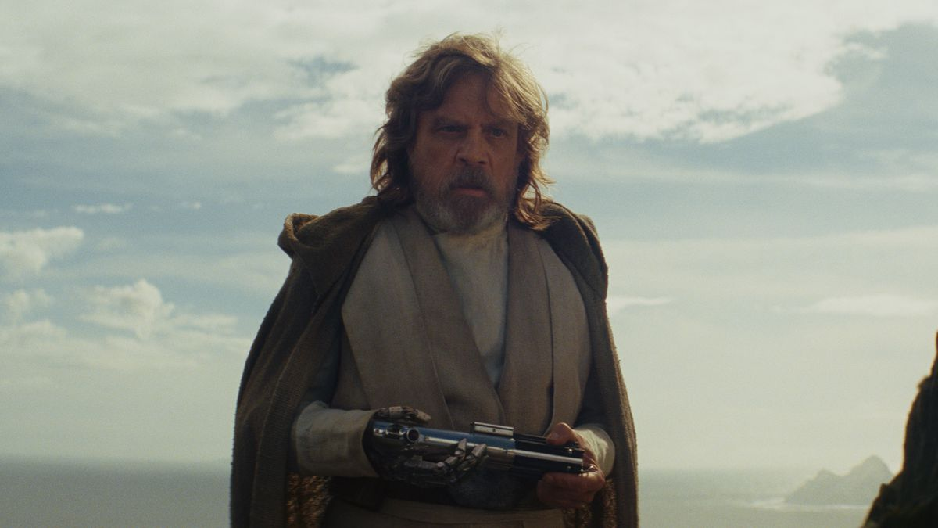

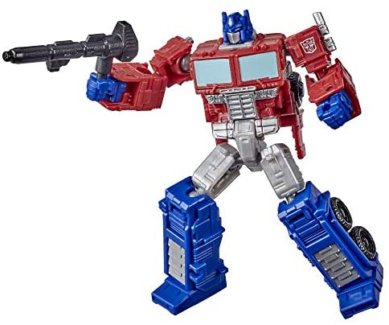
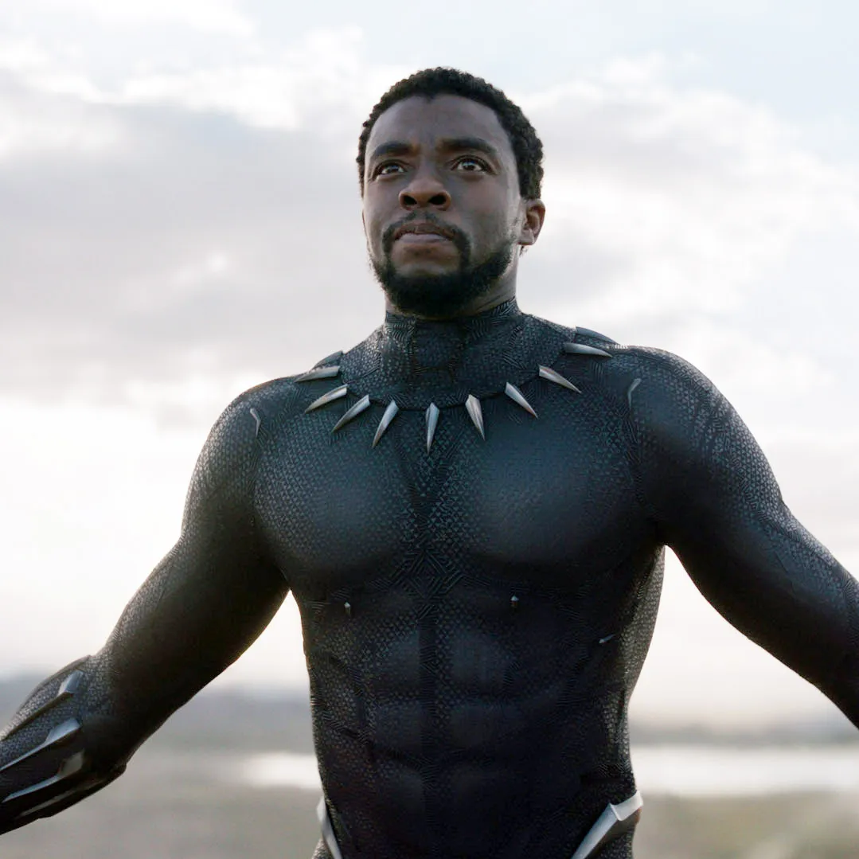

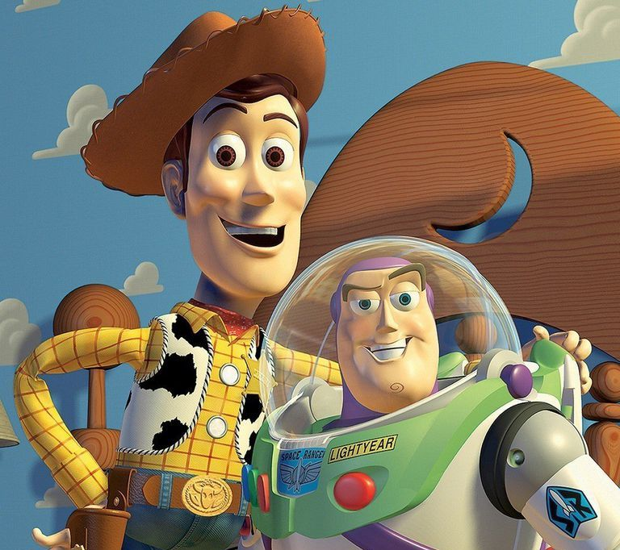
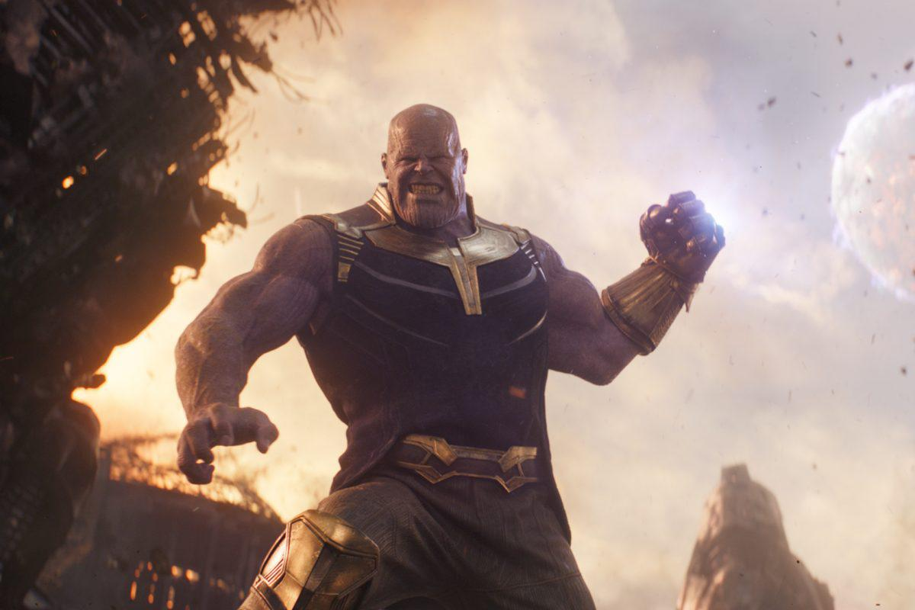

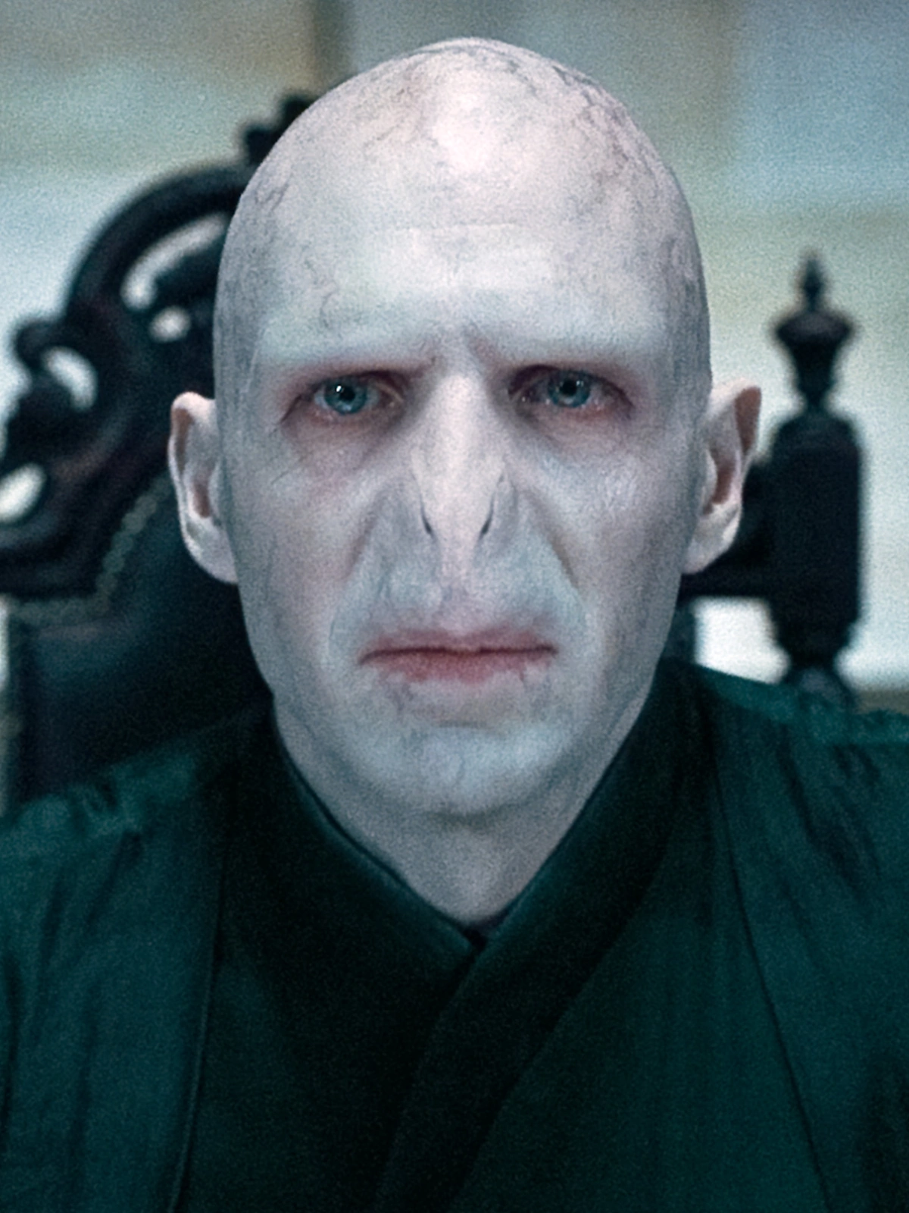

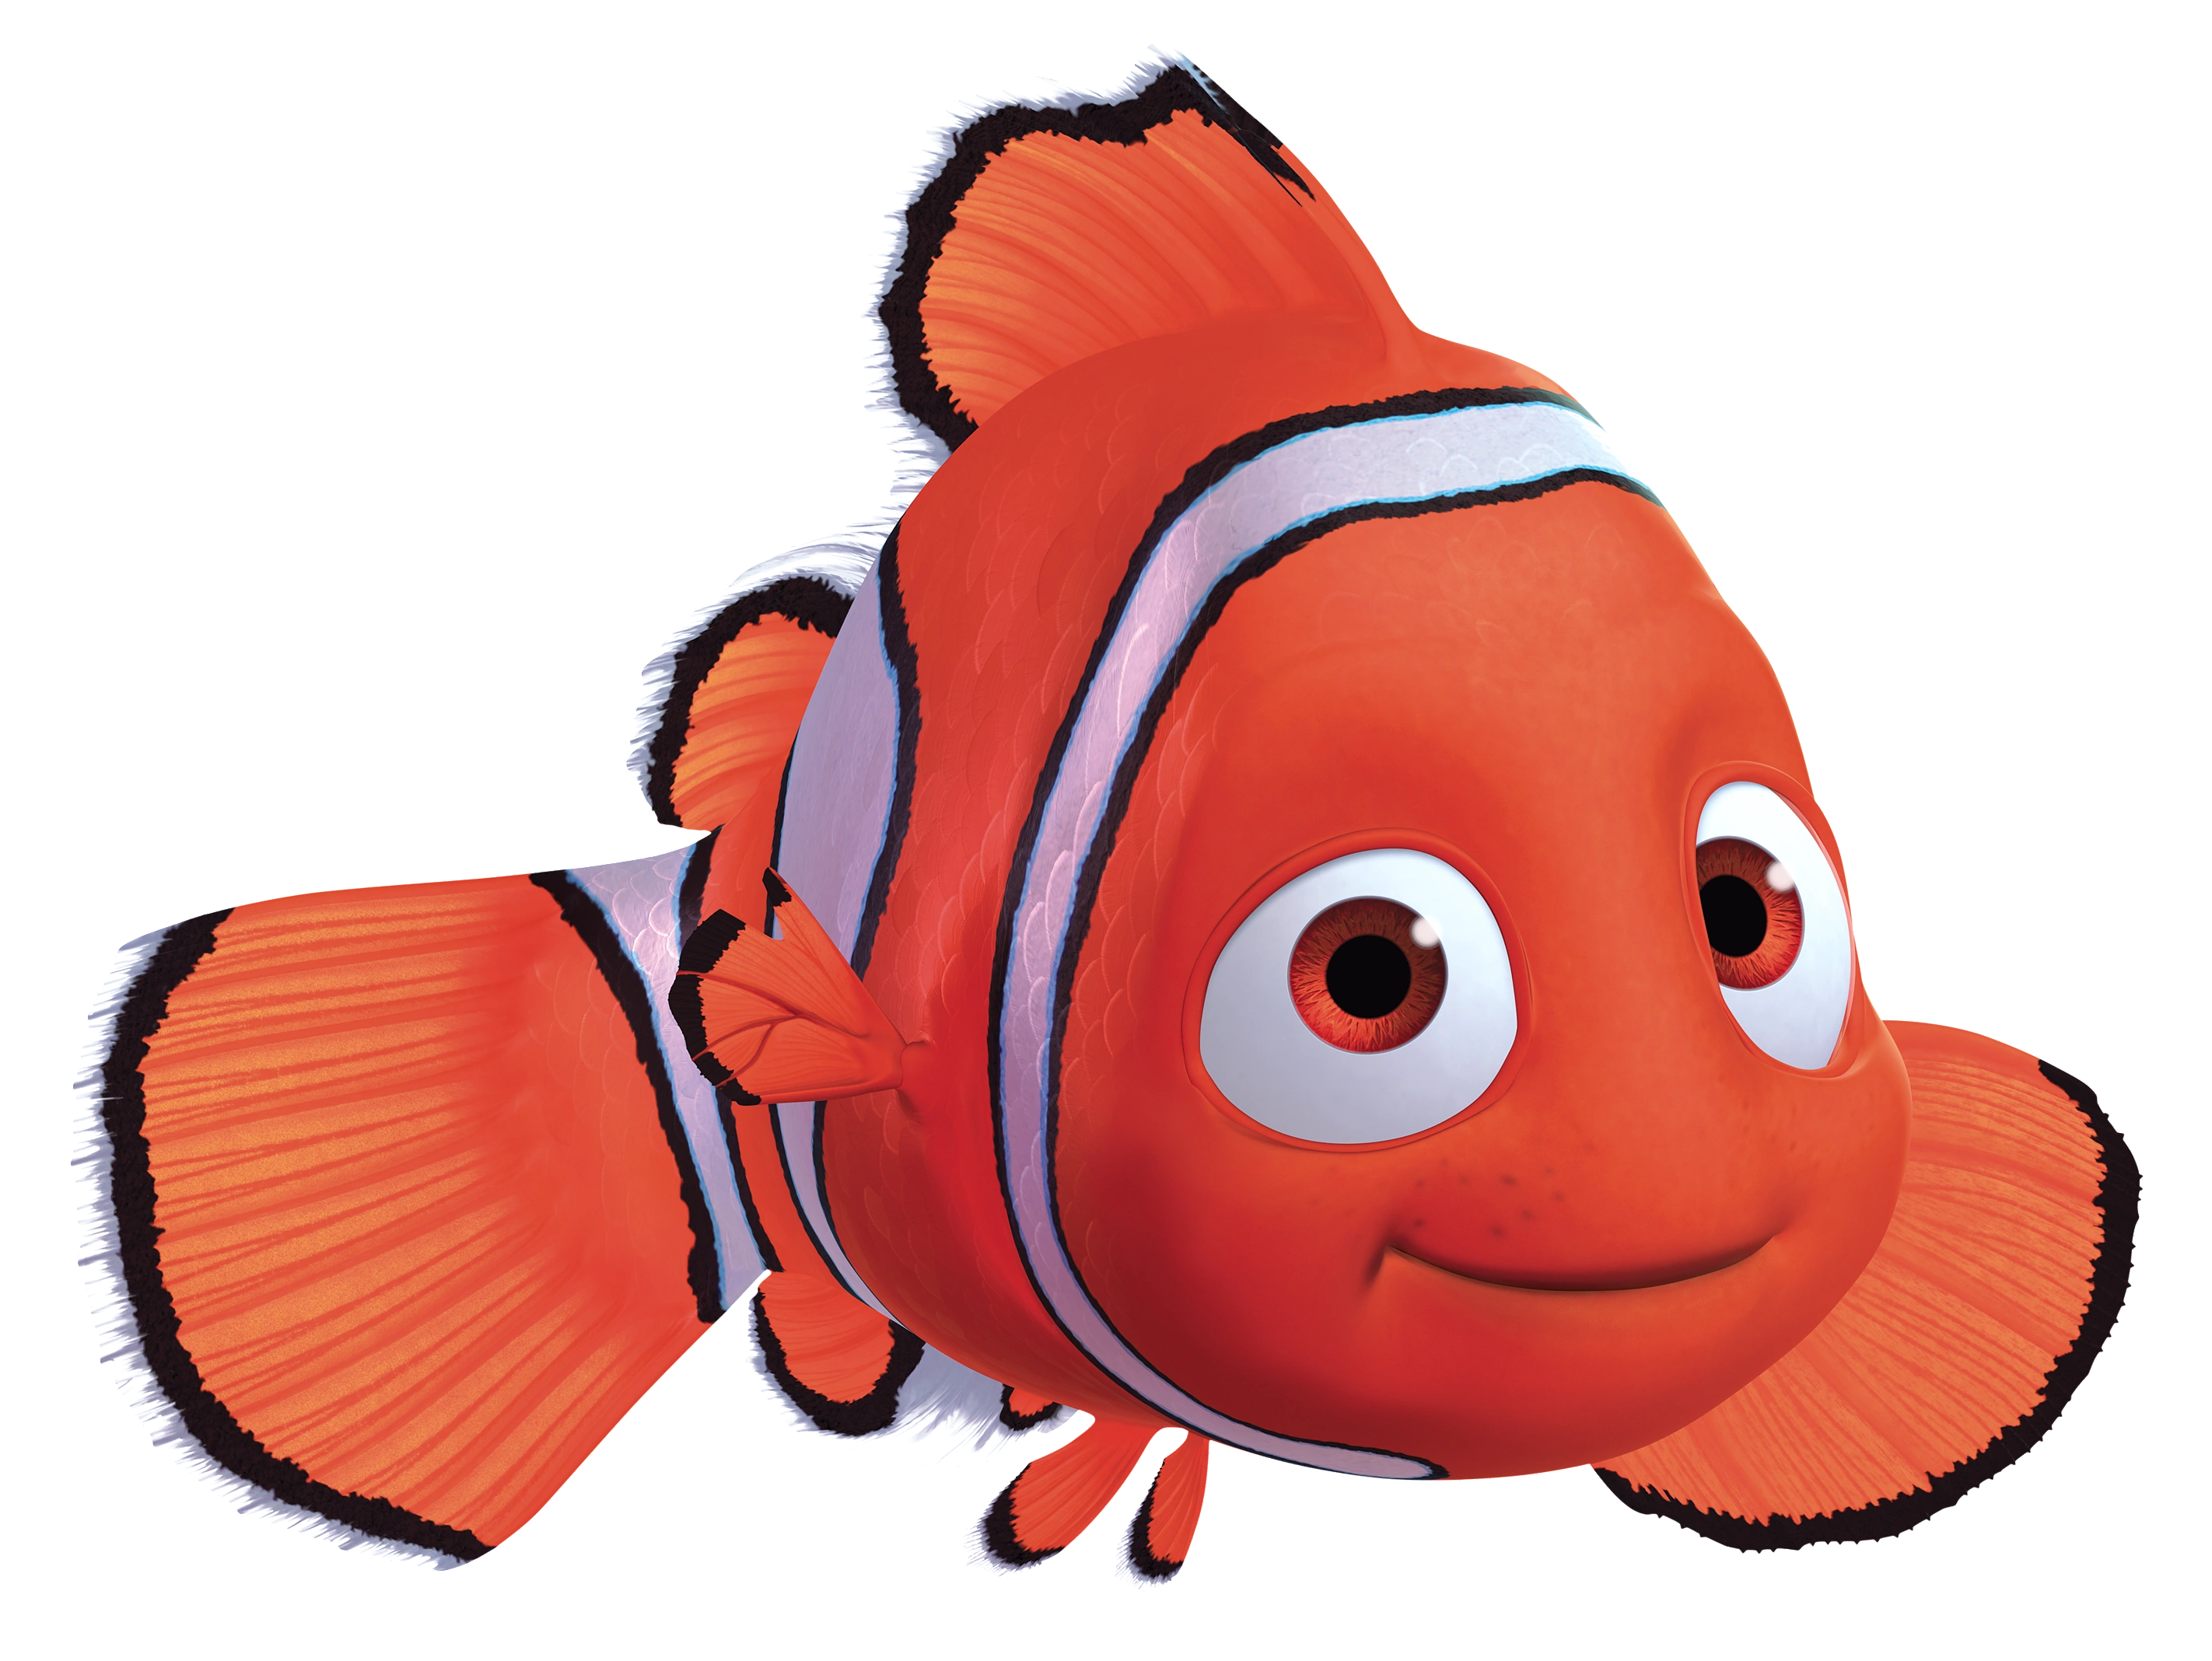

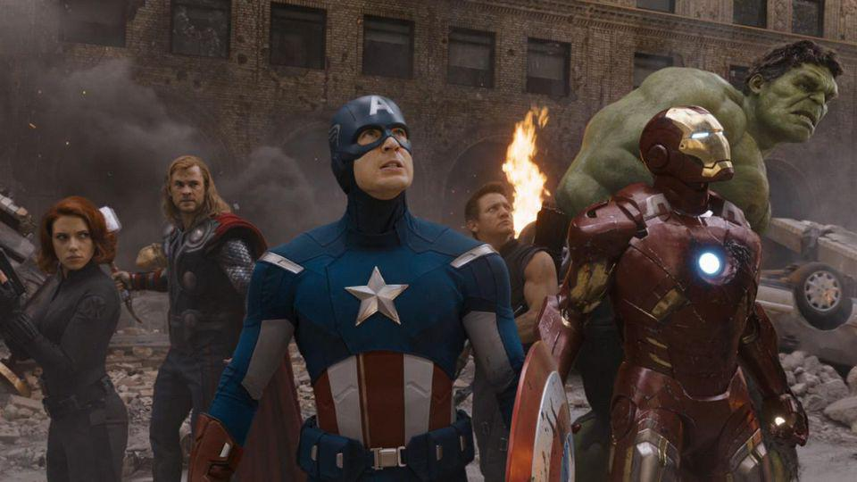
HIGHEST GROSSING FILMS: 1995 - 2021
One cell = $5,980,143.38
Batman Forever
1995
Shrek 2
2004
Iron man 3
2013
Independence Day
1996
Star Wars ep III
2005
Guardians of the Galaxy
2014
Men in Black
1997
Pirates Of the Caribbean
2006
Star Wars ep VII
2015
Titanic
1998
Spider-Man 3
2007
Finding Dory
2016
Star Wars: Ep I
1999
The Dark Knight
2008
Star wars ep VIII
2017
How to Grinch Stole Christmas
2000
Transformers
2009
Black Panther
2018
Harry Potter I
2001
Toy Story 3
2010
Avengers Endgame
2019
Spider-Man
2002
Harry Potter 8
2011
Bad Boys for life
2020
Finding Nemo
2003
The Avengers
2012
Shang-Chi
2021

